Slide 1
Introduction to Cyber Security
Module 2
Security Layers

Slide 2
Topics
Human factors in cyber security,
Perimeter Security,
Network Security,
Endpoint Security,
Application Security,
Data Security,
Privacy.

Slide 3
Introduction
Increased frequency of high-profile breaches
Enormous pressure on IT departments
Improving confidence in one’s IT security requires
solid understanding of all potential vulnerabilities
Solid understanding of most effective best practices
Keeping your business protected against cyber attacks
A big challenge
However, risk can be minimized using Layered Security Approach

Slide 4
What is Layered Security?
According to Techopedia, layered security is defined as:
Layered security refers to security systems that use multiple components to protect operations on multiple levels or layers.
Individual layers in a multi-layered security approach
These layers work together to tighten security.
Purpose of the layered security approach:
Every individual defense component has a backup to counter any flaws or gaps in other defenses of security
Layered approach to network security is based on the concept of - Defense in Depth
Good idea to have several barriers
Attacker has to do a lot of work
Protective skin around the network
Each layer has its own set of protections and security controls.

Slide 5
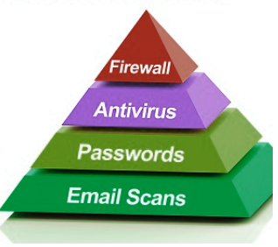
The Importance of Layered Security Architecture

Slide 6
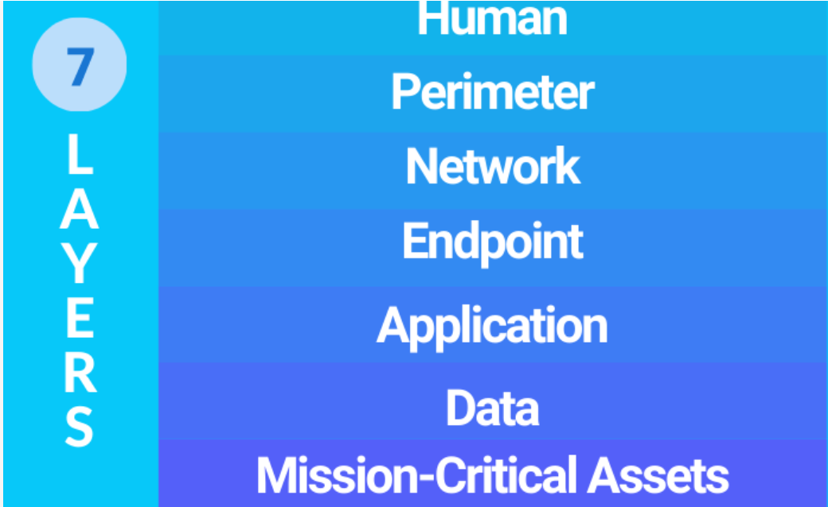
Seven Security Layers

Slide 7
Mission Critical Asserts
Anything your business can’t survive without.
Operating systems, electronic health records, software tools, financial records, and cloud infrastructure.
Assets you need to protect at any cost

Slide 8
Data Security
In almost every instance, data is the target
This layer requires the most attention
Customer data, payment information, aadhar card numbers, business secrets (and other intellectual property), etc.
Losing this data
erodes your customers’ trust in your business,
huge regulatory fines,
about 50% of the time, causes your business to close.
Data security controls protect the storage and transfer of data
Different tools can be used
multifactor security,
authentication and encryption,
regular backups of all critical data

Slide 9
Application Security
Applications security controls protect access to an application,
an application’s access to your mission critical assets, and the internal security of the application.
Application layer revolves around the software we use in our business.
Microsoft Office, Slack, Zoom, antivirus, web server s/w, etc.
Issues with the outdated software:
Full of vulnerabilities, or security holes.
Can be overcome with patching
Process of distributing and applying updates to software and firmware.
This helps ensure that any known security problems are fixed and that the application is as secure as possible

Slide 10
End Point Security
Any device that is connected to your business network
Laptops, workstations, mobile devices, printers, scanners, copiers, security cameras, and more.
End devices are potential entry points for hackers.
Thus, they need to be included in your organization’s cybersecurity plan.
Computer hardening
Tools and methods to achieve this security include:
Anti-virus and anti-malware applications.
Endpoint security measures and Host Intrusion Detection Systems
The removal of redundant or unused applications, services, and protocols.
Effective management of ports.

Slide 11
Network Security
Protects an organization’s network.
Prevent unauthorized access of the network.
This layer comprises the actual software and hardware dedicated to protecting the network in part or whole.
Protection here extends from
Enabling the on-board security features of routers and switches to the installation and configuration of firewalls, IPS, and IDS.

Slide 12
Perimeter Security
Outer layer of your network.
Subset of Network Security
Attempts to secure the perimeter of a network
E.g. Attacks coming from Internet to a local network
Does not deal with the insider attacks (e.g. ARP spoofing)
Also applicable to security of assets such as web server, mail server, etc. which are stored in DeMilitarized Zone (DMZ).

Slide 13
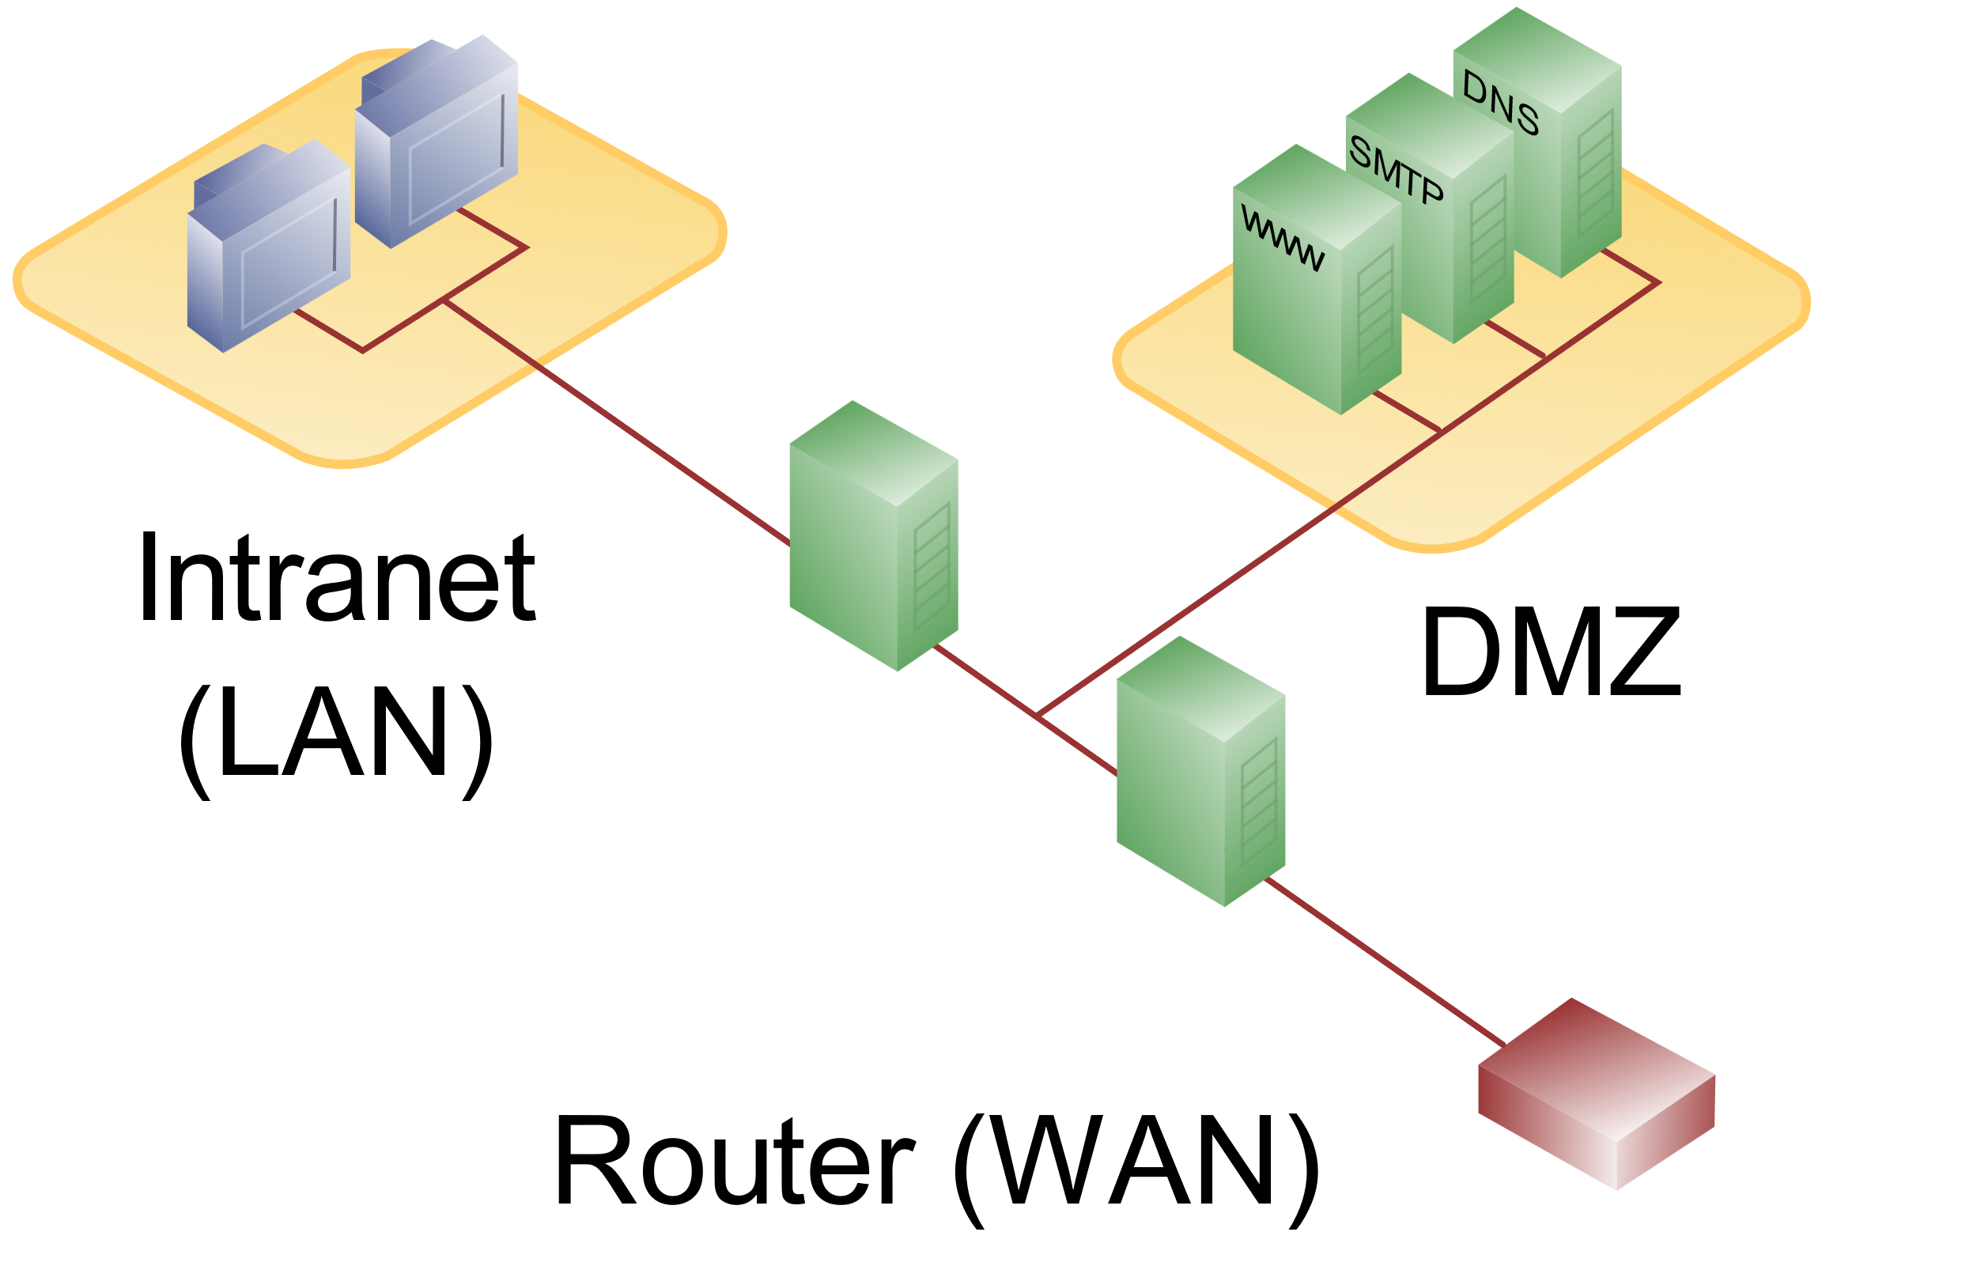
Perimeter Security
Sample topology

Slide 14
Human Layer
Humans are the weakest link in any cyber security chain.
According to reports, upwards of 90% of all security breaches are caused by humans.
Social engineering attack, insider attack
Best approach to keep this layer secure is education and training.
Training programs for good cyber security habits
This includes instruction on how to spot a phishing attempt, good password habits, and information on current scams to be on the lookout for.
Access controls are also a good idea for securing the human layer since they can limit the amount of damage in case there is a successful attack

Slide 15
Layered Security as an Industry Best Practice
12 essential security best practices:
Firewall
First line of defense
Monitors the incoming and outgoing traffic
Only allows the traffic that is defined in the security policy
Patch Management
Mitigates issues with the outdated softwares
Addresses the functionality errors or bugs
Boosts performance
Multifactor Authentication
Requires multiple forms of verification to access an application, account, etc.
E.g. password followed by OTP
Endpoint protection
Web Content Filtering
Blocking users’ access to websites
Content can be blocked by specific categories also

Slide 16
Layered Security as an Industry Best Practice
12 essential security best practices:
Email Filtering
One of the most common cyberattack vectors
94% of the malwares are delivered by email
Only a single click on a malicious URL required to grant access to an entire network
Prevents phishing attacks, ransomware, viruses, malware, etc.
Security Awareness Training and Phishing simulations
What if an email slipped past your email filter?
Employees should be able to recognize phishing emails.
One-third of the reported data breaches involve phishing emails.
Training on cybersecurity basics and best practices is essential
Periodic phishing simulations
Sophisticated Password Policy
A strong ‘NO’ to duplicate passwords
One account breach may lead to breach of another account also
Policies for password strength and complexity

Slide 17
Layered Security as an Industry Best Practice
12 essential security best practices:
Dark web monitoring
Home to many illegal activities
Sale of sensitive and personally-identifying information stolen
Employee credentials are best sellers on dark web. Why?
Dark web monitoring tools scan for emails and passwords associated with a company domain
Physical Security
Firewalls can’t protect data from being copied and stolen via a USB drive.
That’s why physical layer security is important.
Restricts access to and protect your on-premises infrastructure and spaces in which data is stored.
Examples – keycards, door locks, security cameras, security personnel, etc.

Slide 18
Layered Security as an Industry Best Practice
12 essential security best practices:
Business Continuity and Disaster Recovery
Mitigate the downtime due to attack
Continue the business even in the presence of the attack
Restore the data from backup
Two important reminders:
Isolate your backup from the main network
Ensure your business continuity plan is documented, tested, and regularly updated
Managed Detection and Response (MDR)
How do you detect when someone or something has gotten past your other layers of protection?
Advanced security solution that combines next-generation monitoring software and a 24/7 (human-staffed) security operations center
to identify and isolate suspicious behavior on your network in real-time
Without a detection and response tool:
it can take more than 200 days to discover a data breach,
Hackers get plenty of time to plan and execute a devastating attack before you are even aware of a problem.

Slide 19
The Essential Layers of IBM i Security
These layers cover:
physical devices
Networks
configuration of the IBM i OS,
access to systems,
protection of data,
and monitoring and auditing of systems.
Overlapping layers, so multiple line of defense.
In other words, should one security layer be somehow compromised, there’s a good chance that another layer will prevent a potential intruder.

Slide 20
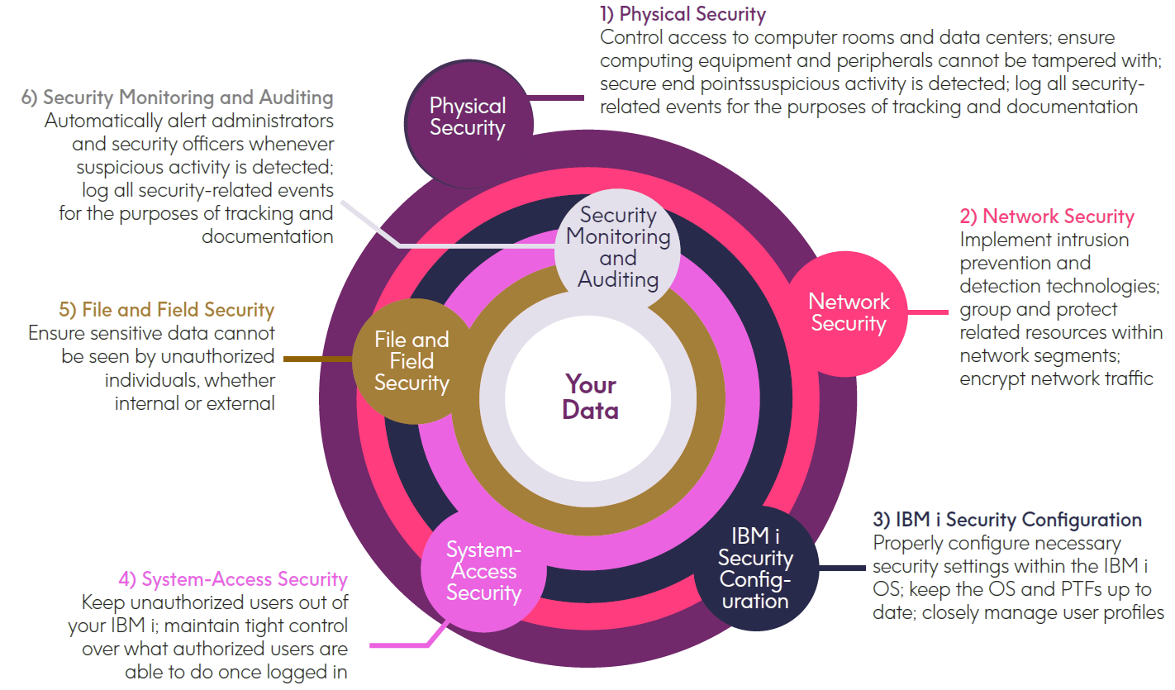
Layers of IBM i Security

Slide 21


Physical Security
Immovable v/s movable physical security – Which one?
Servers and storage devices
Network devices
Peripheral devices: Keep within secure areas all printers and fax machines that output sensitive information.
End-point devices

Slide 22
Network Security
The networks to which an IBM i is connected must be carefully secured, and if any of these networks are connected to the Internet, extra vigilance is required as Internet-connected networks often see thousands of access attempts each day by bots, sniffers, and hackers.
Firewalls
Iptables
iptables -A OUTPUT -p icmp -j ACCEPT; iptables -A OUTPUT -p icmp -j DROP
IDS and IPS
Not rule based
Anomaly detection based on the network traffic behaviour
3. Network segmentation — Partition a network into a subnetwork
4. Encryption of network data

Slide 23
System-Access Security
It helps keep unauthorized people out of IBM i environments while maintaining tight control over what authorized users are able to do once logged in.
Password management
Multi-factor authentication
Network-access control — Unauthorized access via sockets and network protocols must be prevented.
Command control — Locking down some commands (chown, chgrp, etc…).

Slide 24
File Security
Object-level authority management: Sensitive file should be protected from public access. Designated users can then be given specific authority to access these files through private authority.
Row and Column Access Control (RCAC): prevent selected users from viewing specified rows in a file and/or data in particular columns.
Encryption
Tokenization of field data: Alternative method of shielding sensitive data by replacing the data with non-sensitive substitute values called tokens.
Third-party tokenization solutions utilize a database called a token vault (residing on a different server) to store both the sensitive data and information about the relationship between it and its replacement token.
Tokenization is often used to replace credit card numbers, social security numbers, and other personally identifiable information.
Anonymization:
Similar to tokenization solutions
Anonymization solutions differ by eliminating the use of a token vault, thus permanently replacing sensitive data with a substitute value and making the original data unrecoverable.

Slide 25
Practice Problems
Simple example of an encryption/decryption technique:
Ygneqng vq eadgt ugewtkva
Decode the sentence
Write a program (language of your own choice) to 1) ask user for a string and a key as the inputs and to give an encrypted string as the output.
2) ask user for an encrypted string and a key as the inputs and to give a decrypted string as the output.
Try iptables commands and show the output:
iptables -A OUTPUT -p icmp -j ACCEPT
iptables -A OUTPUT -p icmp -j DROP

